Slide 1
The Economic Motivations for Using Project Finance Author: Benjamin C. Esty Date: February 14, 2003
Presenter: Kevin Shen
Presentation Date: October 12, 2016

Slide 2
Agenda
Modigliani and Mill’s Proposition
Project Finance
Analysis of Economic Motivations
Agency cost: ownership and control
Under-investment: debt overhang
Under-investment: incremental distress costs
Author Conclusion
My Opinion

Slide 3
Modigliani and Mill’s Proposition Capital-Structure Irrelevance
In a perfect market with no frictions, firm value is solely determined by its earning power and by the risk of its underlying assets, independent of its financing choices
Assumptions:
No taxes (corporate, personal)
No transaction costs
No bankruptcy costs
No agency costs (ownership/control, debt/shareholders)
Information symmetry

Slide 4
Project Finance Financing Product
One of the most important financing vehicles for investments in the natural resources and infrastructure sectors such as power plants, pipelines, toll roads, airports, rail roads, and telecommunications systems

Slide 5
Project Finance Market Size Comparison
Source: paper, data as of 2001

Slide 6
Project Finance Project Structure Components
Organizational Structure: legally independent from the sponsors; secured debt, a corporate obligation, does not
Capital Structure: very high leverage (~70%) compared to public corporations (~30%)
Ownership Structure: highly concentrated debt (~1-4 bank loan syndicates) and equity ownership (~1-3 sponsors) structures; bank debt is non-recourse
Contractual Structure: many parties (~10-1000+) involved in a vertical chain; four major project contracts are Equipment, EPC, O&M, and Purchase Agreement

Slide 7
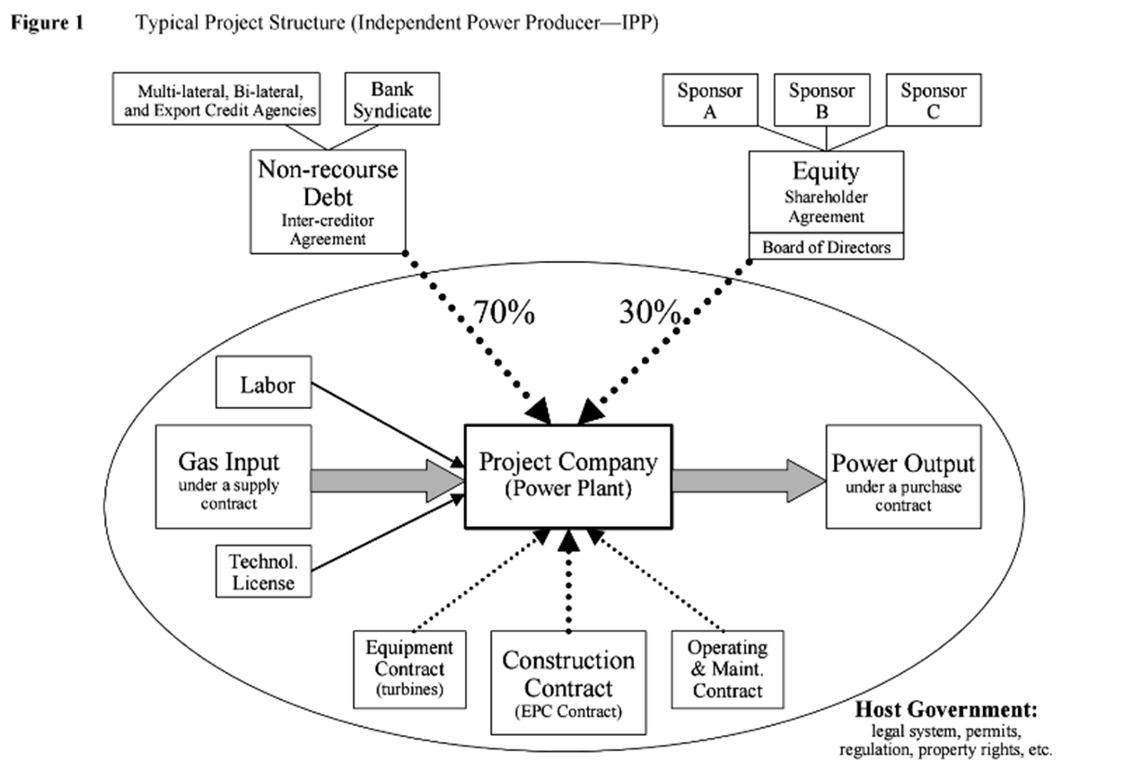
Project Finance Typical Project Structure

Slide 8
Project Finance Costs & Benefits of Project Finance
Timing: 6-18 months more
Costs: significant transaction costs (~3-5%), Klein, So, and Shin (1996)
Spreads: 50-400 bps more (no cross-collateralization on cash flows and assets), Lewellen (1997)
Deadweight costs (DWC): transaction, agency, distress, information, taxes, etc.
Framework of analysis is created below based on Myers’ (1974) adjusted present value (APV) methodology:
Investment value = (project value) – (project DWC) – (incremental firm DWC)

Slide 9
Project Finance Motivation 1: Ownership/Control
No mergers and acquisitions, takeover, or liquidation market
Project company equity is privately held by the sponsors
Projects generally have construction period and limited lives (not worth much, and decreasing net asset value)
Remark: when opportunity for incentive conflicts exists, it might be worth the transaction costs to minimize agency costs
“Cash Flow Waterfall” limits managerial discretion
Waterfall prioritizes claims on cash flows
Eliminates conflicts between debtholders and equityholders regarding distribution and re-investment of cash flows and restructuring in distressed situations
Remark: simplifies the situation of legal proceedings when project goes under water compared to fighting internally at the sponsor level

Slide 10
Project Finance Motivation 1: Ownership/Control
Concentrated ownership in debt and equity
Bank debt instead of bond allows sponsors to gain the benefits of creditor monitoring, Diamond (1984)
Unique board appointed by the sponsors rather than a board membership for public corporations
High leverage
Project debt repayment is solely dependent upon project cash flows rather than through corporate cash flows
Short term bank debt (miniperm, ~3-5 years)
Remark: force managers to focus on performance and managing projects

Slide 11
Project Finance Motivation 2: Debt Overhang
Debt overhang is when a corporation has existing debt so great that it cannot borrow more money, even for positive NPV projects
Project finance helps
Highly leveraged firms avoid this opportunity cost of underinvestment
Moderately leveraged firms to raise additional funds without becoming highly levered
Allows sponsors to preserve scarce corporate debt capacity, maintain current credit rating, and borrow more cheaply compared to straight new corporate debt

Slide 12
Project Finance Motivation 2: Debt Overhang
Secured debt reduces leverage-induced underinvestment by allocating returns to new capital providers, Stulz and Johnson (1985)
Similar logic, Berkovitch and Kim (1990), John and John (1991), Flannery (1993) showed that project finance achieves the same result through separate incorporation and non-recourse debt
Remark: project finance is more effective than secured debt because it eliminates all recourse back to the sponsors

Slide 13
Project Finance Motivation 3: Distress Costs
Reduce the potential collateral damage that a high-risk project can impose on the sponsors
Project finance can dramatically reduce the potential for risk contamination
Remark: for investments with high expected distress costs, project finance may reduce the incremental distress costs to the point where the total combined NPC is positive

Slide 14
Project Finance Conclusion
Relatively new yet large field of finance that lacks academic research
Project finance reduces the net cost of financing particular assets through three economic motivations:
Agency costs reduction
Debt overhang costs reduction
Distress costs reduction

Slide 15
Project Finance My Opinion
Rudimentary research on project finance that shed lights on this growing field of finance from a risk management perspective
Good: referred to a lot of research in the paper
Bad: lack of statistical information to back up the results
Further research: paper focused on the project level, further research into the cost of borrowing at sponsor level could be proven useful in practice

